Slide 1


// Project Presentation on
Details =
“B. Tech. (CSE) – 4th Year
Sec-A
Session : 2018-19” ;
Group Members {
Anuj Mishra ();
Astitva Srivastava ();
}

Slide 2
INTRODUCTION
Before emerging into specifics, let’s discuss
Some general problems which led to the birth of
this idea called ZORO.
ZORO is a bridge connecting people
who wish to provide or avail products & services
in more of a tenantive fashion.

Slide 3
Features of ZORO

Slide 4

MAIN FEATURE
RENTING

Slide 5

HOW RENTING HELPS ?
From Customer’s point of view :
Access to amenities you can’t afford to buy
No maintenance costs or repair bills
No financial taxes for the product
Pocket friendly

Slide 6

HOW RENTING HELPS ?
From Lender’s point of view :
Earning from products which are not largely in
own usage.
Increases reusability of product.
High reachability of products.

Slide 7
HOW ZORO WORKS?
Login – as customer or lender
CUSTOMER:
Choose what you want on rent.
Select from categories or search specifically.
Select the best option based on ratings, reviews
or price.
Contact with lender for formalities and paperwork.
Pay according to duration of usage.
All set !!!
LENDER:
Choose what you want to provide on rent.
Select from categories or create a new one.
Upload images, price, availability duration, renting period, and other relevant details.
Wait for the customers to contact you.
All set !!!

Slide 8

TECHNOLOGY
IMPLEMENTED

Slide 9
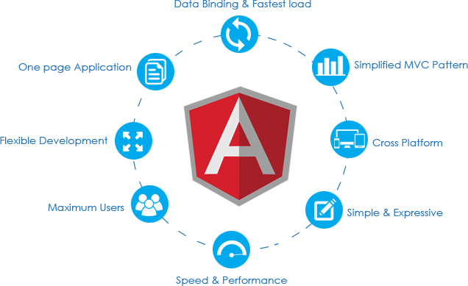
FRONT END

Slide 10

BACK END

Slide 11
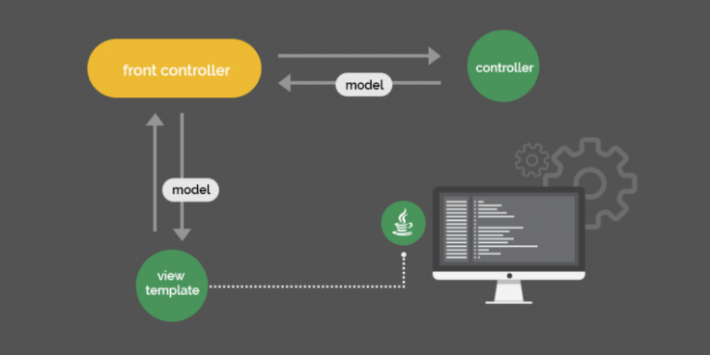
Follows MVC Architecture

Slide 12
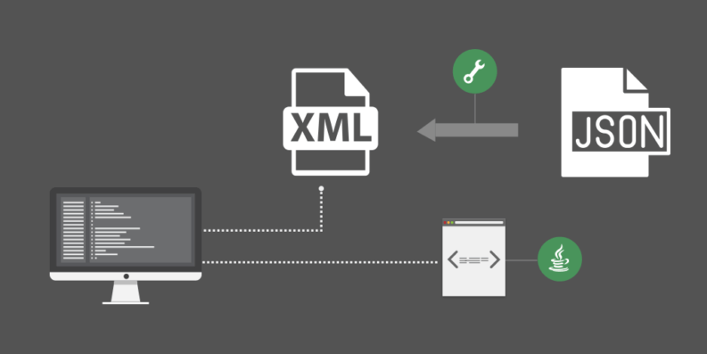
Client & Server communicate through
JSON objects which is more reliable than XML

Slide 13

Database tools include JDBC (MySQL) along with Hibernate ORM, which
ensures privacy of user’s data. Spring’s security features provides
encryption techniques for secure transmission of data.
For future aspect, database might probably shift onto NoSQL platform.

Slide 14

YES, IT IS SECURE
IS IT SECURE ?
Verification of customers and lenders through
Aadhar - UID to avoid frauds.
Proper paperwork regarding rent agreement.
Online payments through secured gateways.
Proper validation from our side in case of
property or vehicles.

Slide 15
OTHER FEATURES
(REGARDING FUTURE ASPECT)

Slide 16

SHARING
Share rides or movie tickets
Exchange goods
Group Shopping

Slide 17

INTRA - DELIVERY
Courier service within a city.
Save your time
Ease of transportation of goods

Slide 18
HOW ZORO WILL GENERATE REVENUE?
Through advertisements.
By paid promotion of legitimate users.
Through courier service.

Slide 19
ADVANTAGES OF ZORO
Collaborating suppliers and needy ones.
Providing a variety of options to choose from.
Promoting flexible lifestyle by keeping you into the trend.
Creating employment opportunities.
Reducing pollution and fuel crisis, thereby helping environment.
Can help lesser known lenders to expand their business.
Can reduce product’s cost, thereby causing a decline in inflammation
and improving economical conditions.

Slide 20
LIMITATIONS OF ZORO
Needs in-depth knowledge of changing market demands.
Developing trust of customers will be difficult.
Project will require complex and expensive advertisement
strategies during its initial stage.

Slide 21

CONCLUSION
ZORO has the capability to introduce the
element of flexibility in the lifestyle of people,
to make the way of living easier and comfortable
by providing a quicker way of sharing products and
services, and at the same time can contribute
towards socio-economic growth.
With necessary contribution and co-operation,
ZORO can change the face of modern economy.

Slide 22


THANKS FOR LISTENING.
ANY QUESTIONS?

